Slide 1
Introduction to eSight 21.0 Application Management

Slide 2
Upon completing this course, you will be able to:
Get familiar with eSight application management features.
Get familiar with the deployment of eSight application management.
Understand routine O&M of eSight application management.

Slide 3
1
Features
2
Deployment
3
Routine O&M

Slide 4


eSight Application Management Features
Resource monitoring
Overview
Resource adding: Operating systems, databases, and web applications can be added for management.
Alarm management
Resource adding
Resource monitoring: Basic operating system information (release version, software version, vendor, kernel version, the number running days, CPU, memory, disks, and processes), database information (version, vendor, and the number of connections), and web application statuses (response time) can be monitored.
Resource management
Alarm monitoring: Alarms of operating systems, databases, and web applications can be monitored.
Performance monitoring: Both real-time and historical operating system performance, such as the CPU, memory, and disk usage, can be monitored.
Performance management
Large screen monitoring: Top N CPU, memory, and disk usage of operating systems can be displayed on a large screen.
Large screen monitoring

Slide 5
1
Features
2
Deployment
3
Routine O&M

Slide 6
Deployment Overview
Resource adding
Monitoring configuration
Use HTTPS, SNMP, and SSH to add the application devices to be managed to eSight.
Device adding
(Optional) Monitoring configuration
Preset, OOTB performance collection tasks, large screens, and report data are provided by default. You can adjust them as required.

Slide 7
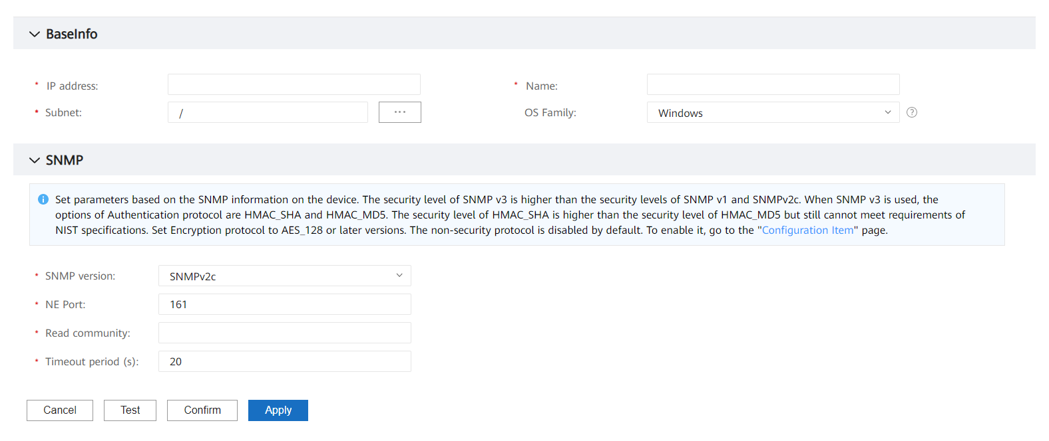
Adding Resources - Adding an Operating System
Operating System
Database
Web Application
SNMP-based adding: Windows Server and ESXi Server operating systems can be managed based on SNMP.
Enter the device IP address, for example, 10.10.10.2.
Select a Windows type.
Select a subnet.
Supported discovery protocol

Slide 8
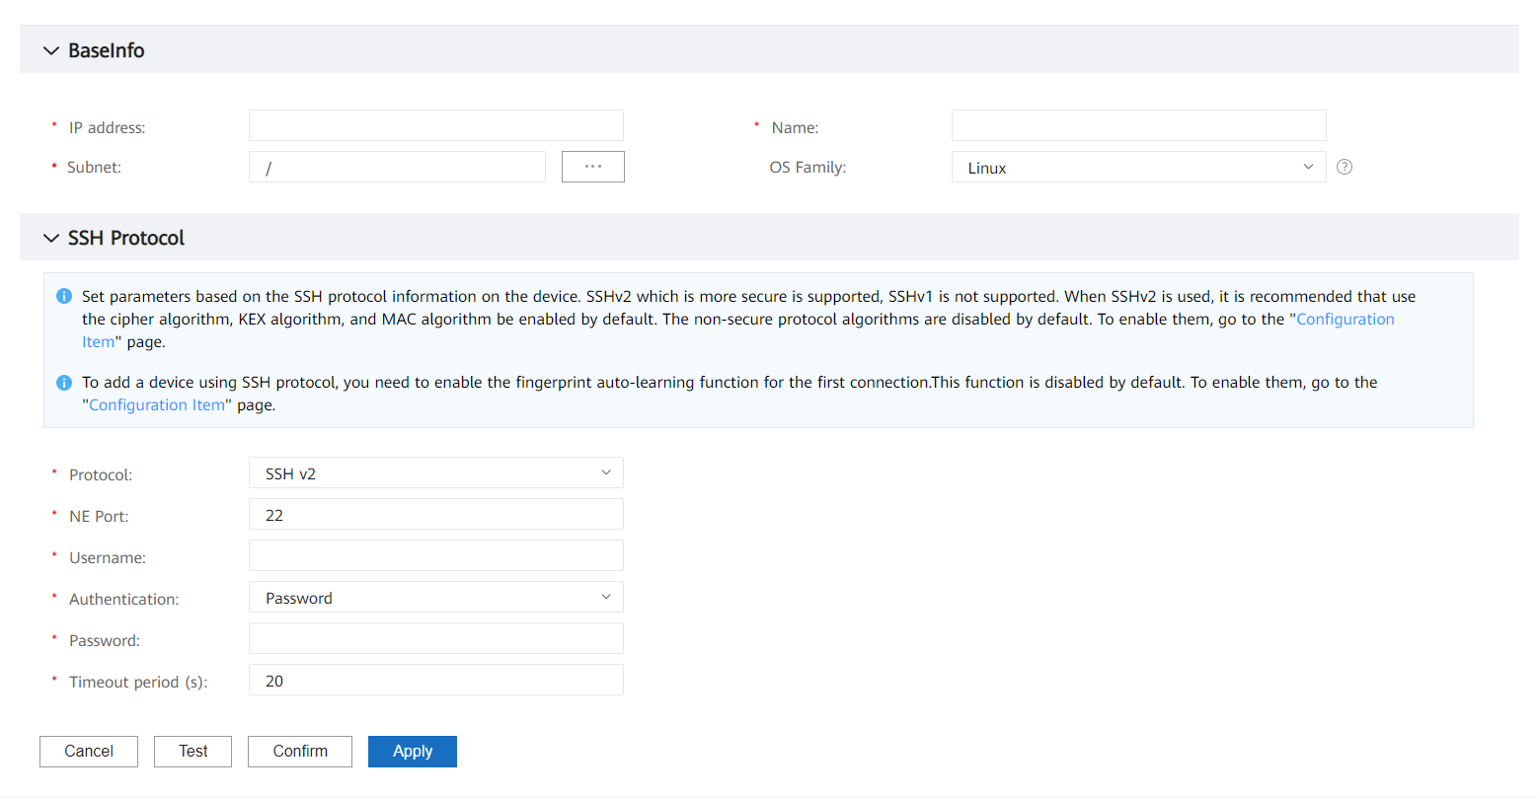
Adding Resources - Adding an Operating System
Operating System
Database
Web Application
SSH-based adding: Linux operating systems can be managed based on SSH.
Enter the device IP address, for example, 10.10.10.2.
Select a Linux type.
Select a subnet.
Supported discovery protocol

Slide 9
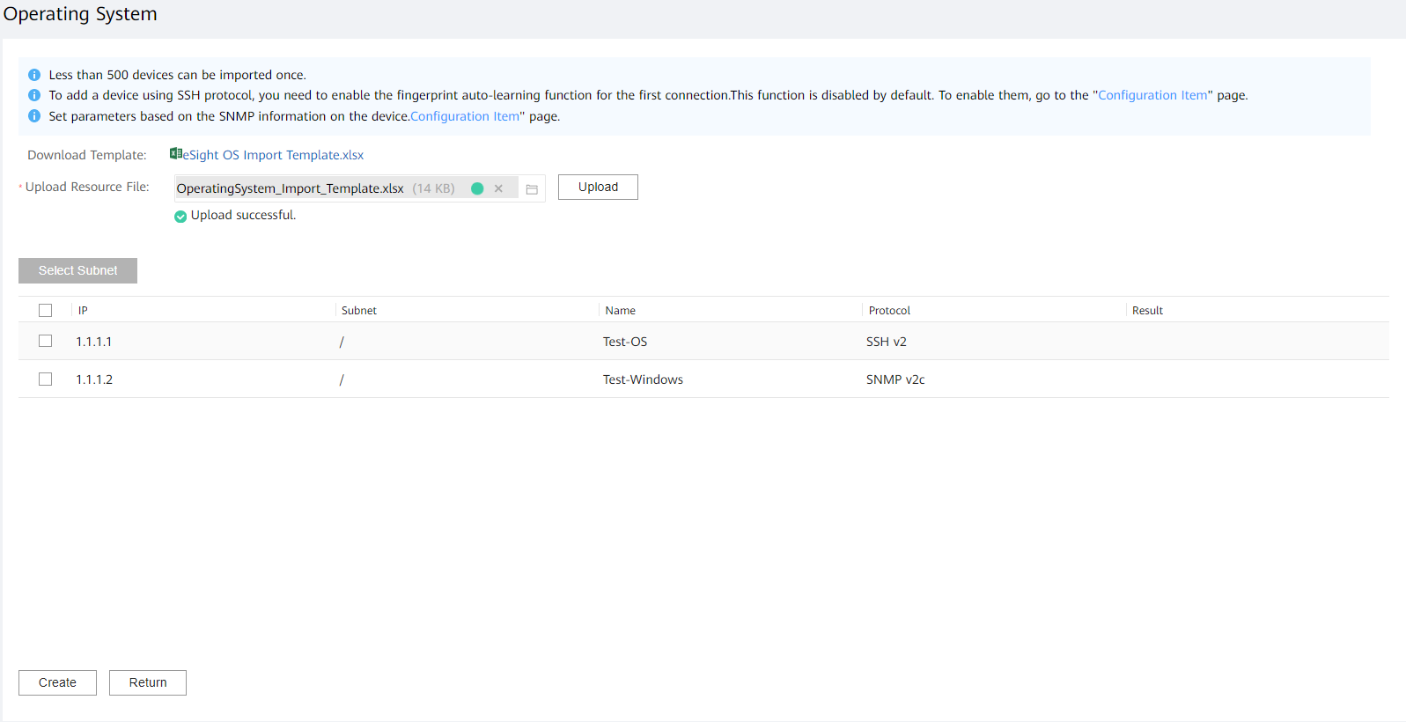
Operating System
Database
Web Application
Adding Resources - Importing Operating Systems in Batches
Batch import: Operating system information can be imported in batches to automatically discover operating systems and improve discovery efficiency.
Download the template.
Upload the file with device information.
Add devices to eSight.

Slide 10
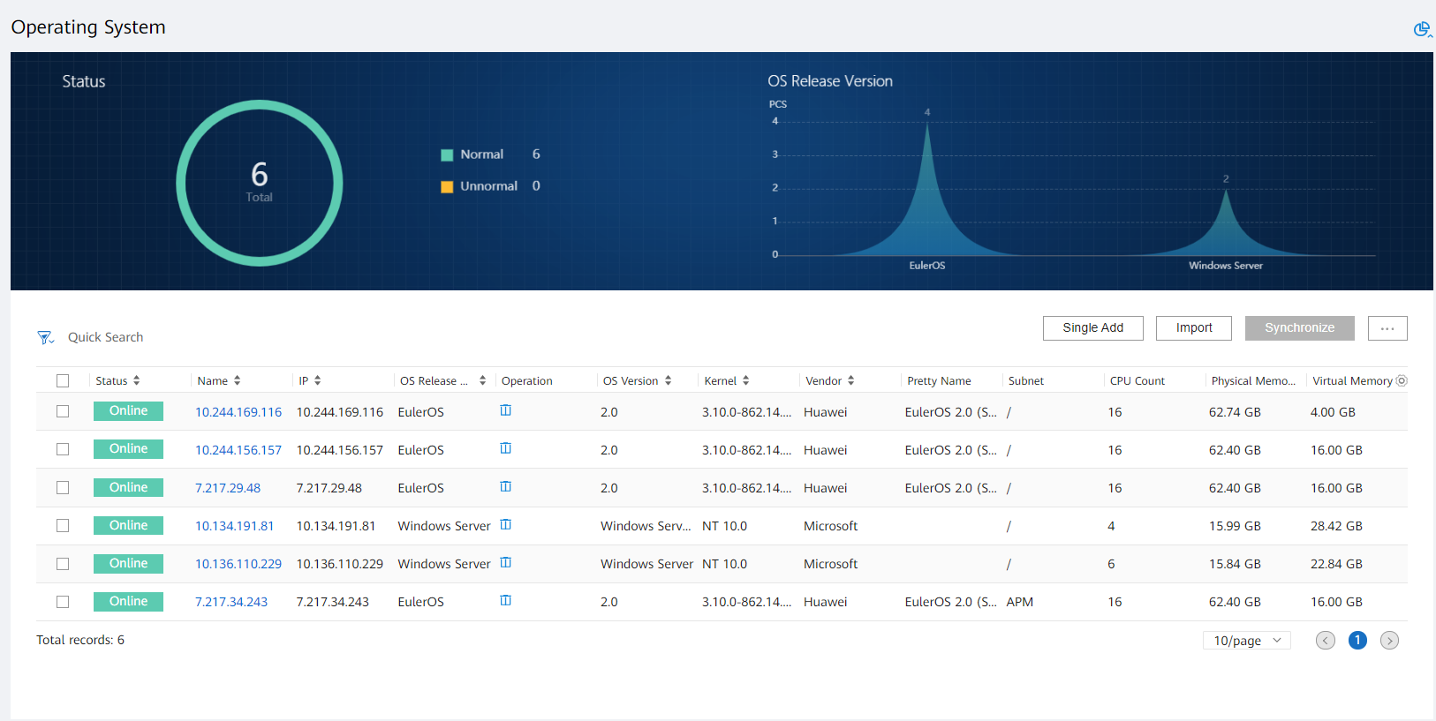
Operating System
Database
Web Application
Adding Resources - Operating System Adding Result

Slide 11
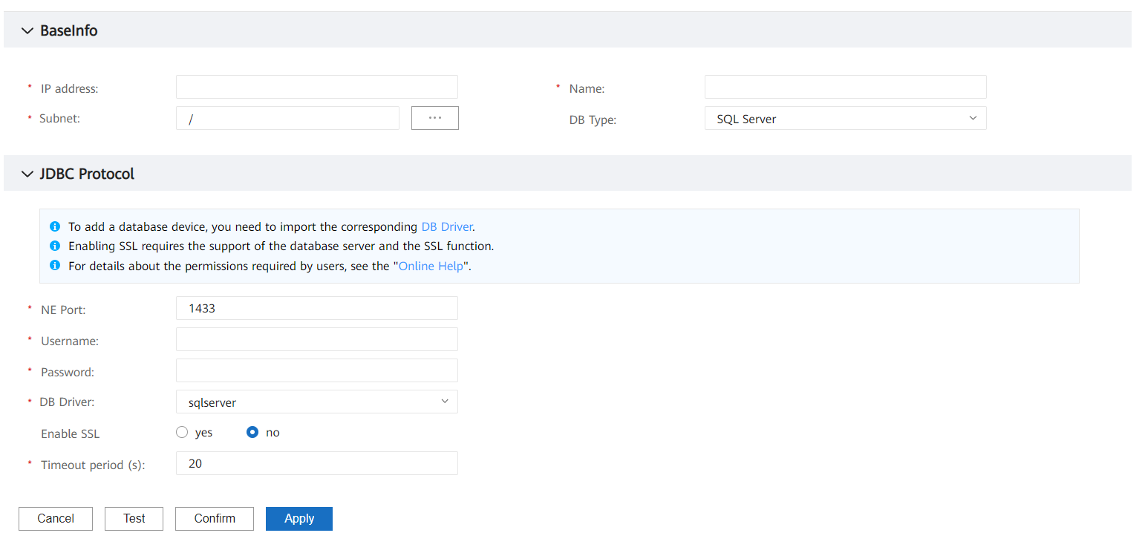
Adding Resources - Adding a Database
Operating System
Database
Web Application
JDBC protocol-based adding: SQL Server, MySQL, Oracle, and Zenith operating systems can be managed based on the JDBC protocol.
Enter the device IP address, for example, 10.10.10.2.
Select a database type.
Select a database driver.

Slide 12
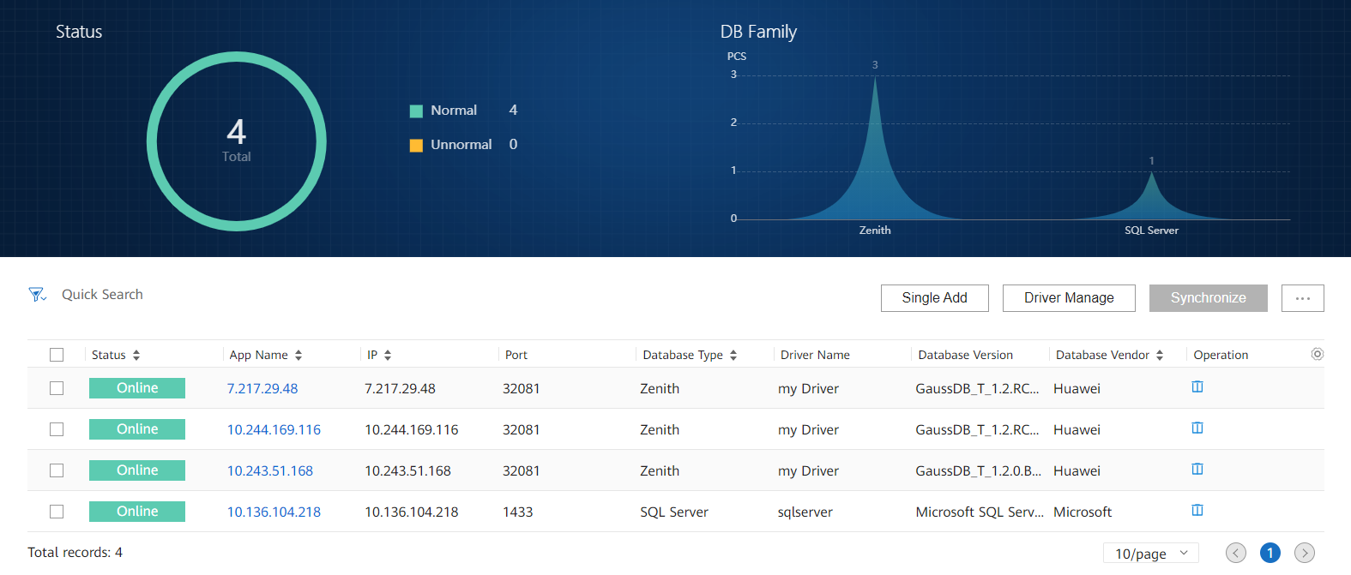
Adding Resources - Database Adding Result
Operating System
Database
Web Application

Slide 13
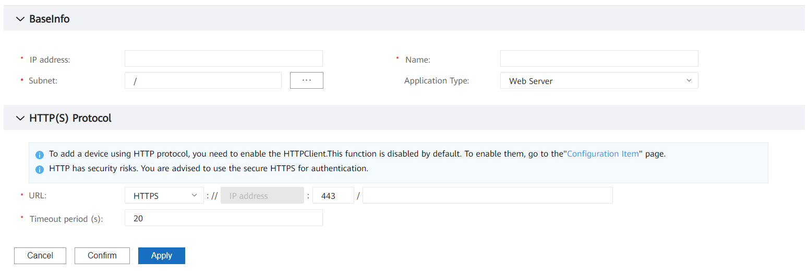
Adding Resources - Adding a Web Application
Operating System
Database
Web Application
HTTPS-based adding: Web applications can be managed based on HTTPS.
Enter the device IP address, for example, 10.10.10.2.
Select a web application type.
Enter the web URL.

Slide 14
1
Features
2
Deployment
3
Routine O&M

Slide 15
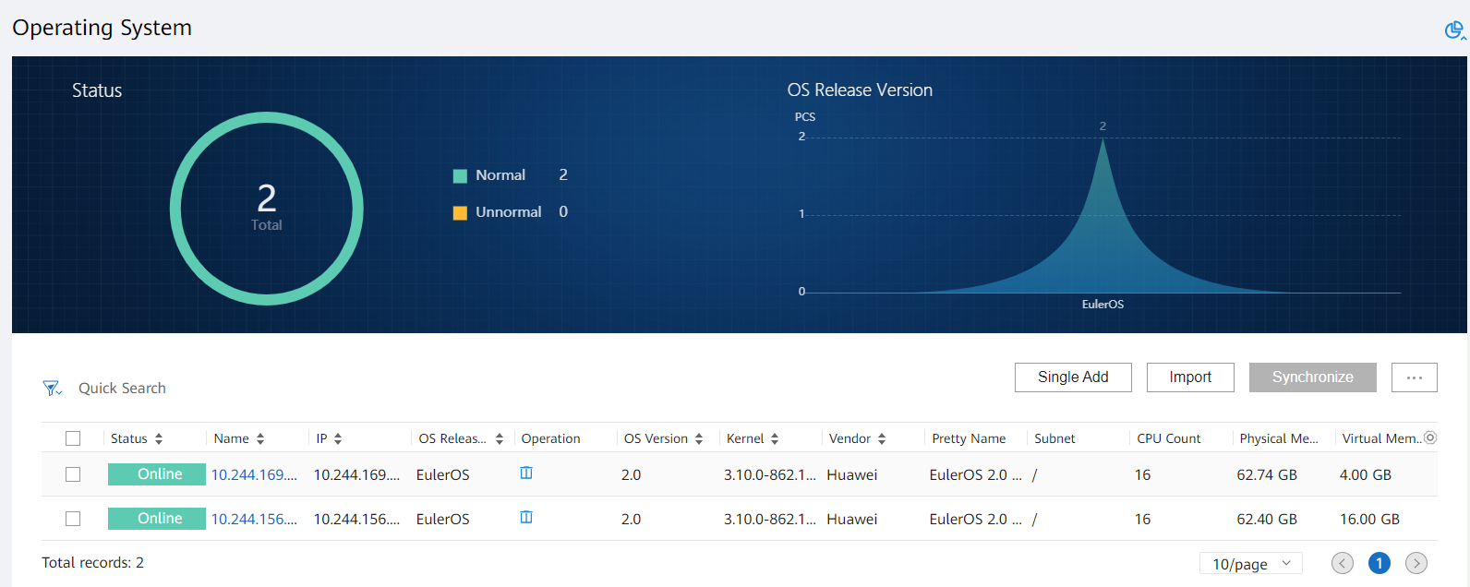
Centrally Monitoring Operating System Monitoring and Performing Asset Stocktaking
Operating System
Database
Web Application

Slide 16
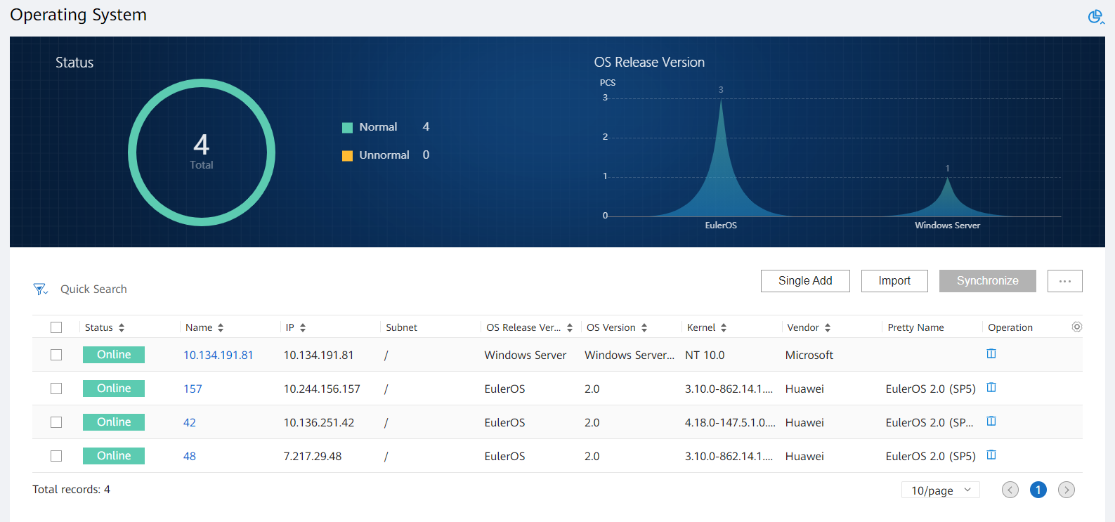
Scenario 1: Centrally Managing Operating Systems
Operating System
Database
Web Application
Customer concerns: Various types and versions of operating systems result in high O&M costs and security risks.
Monitoring capability:
Operating system release versions, software versions, and kernel versions can be collected to monitor the operating system patch installation progress.
Operating system release versions can be merged and classified to streamline operating system operations.

Slide 17
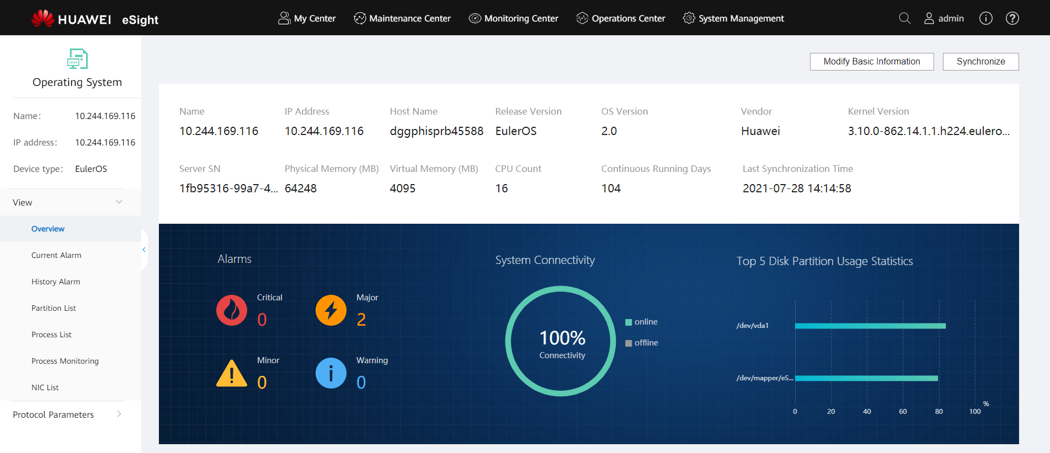
Scenario 2: Monitoring Operating System Breakdowns
Operating System
Database
Web Application
Customer concerns: O&M personnel cannot detect operating system breakdowns at night, which causes service loss.
Monitoring capability:
The unreachable rate of the operating system on the current day can be monitored to analyze the online rate of the operating system on the current day.
Operating system breakdowns can be monitored to trigger alarms and send alarm notifications to O&M personnel by SMS message.
Operating system restart events can be monitored to send alarm notifications to O&M personnel by SMS message.

Slide 18
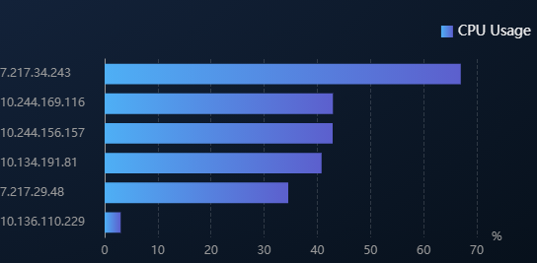
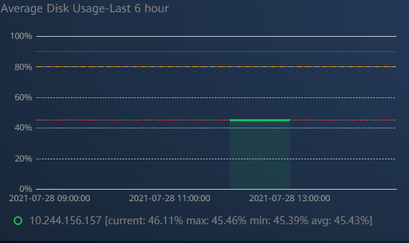
Scenario 3: Monitoring Operating System Loads
Operating System
Database
Web Application
Customer concerns: Operating system loads remain high, which may cause overflow and service loss.
Monitoring capability:
The CPU, memory, and disk usage of operating systems can be monitored to send alarm notifications to O&M personnel when the usage exceeds the thresholds.
Top N CPU, memory, and disk usage can be displayed on a large screen.

Slide 19
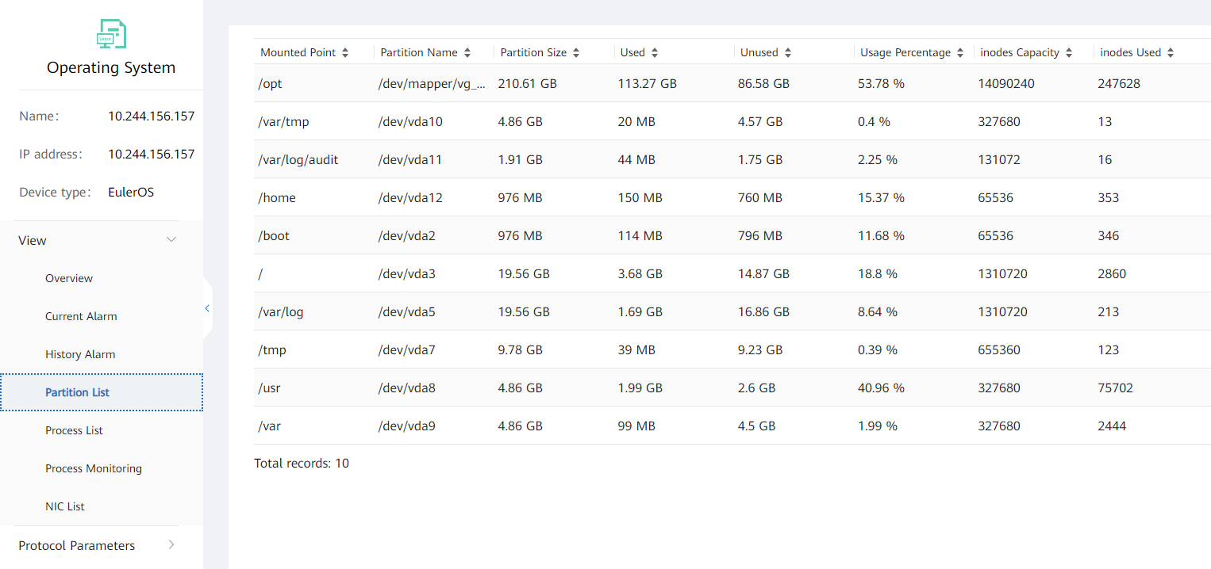
Scenario 4: Centrally Monitoring File System Usage to Prevent Service Interruption
Operating System
Database
Web Application
Customer concerns: The file systems of operating systems are overloaded, or the file systems have remaining space but files cannot be written into the file systems. As a result, core services do not respond, no personnel is available to handle the problem in a timely manner, and services are affected.
Monitoring capability:
The file system usage can be monitored. If the usage exceeds the threshold, an alarm notification is sent to the O&M personnel.
The inode usage of a file system can be monitored. If the usage exceeds the threshold, an alarm notification is sent to the O&M personnel.

Slide 20
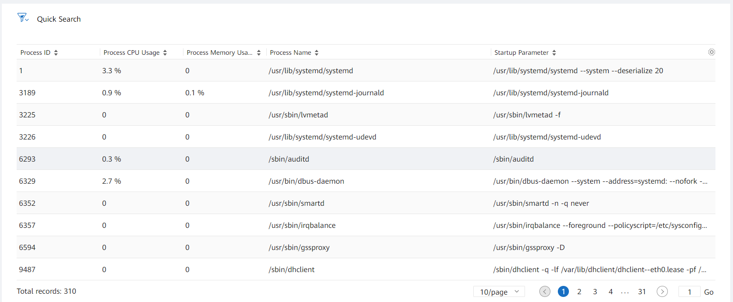
Scenario 5: Detecting Abnormal Processes Based on Process Information
Operating System
Database
Web Application
Customer concerns: The CPU and memory usage of servers exceeds the thresholds, and alarms are frequently generated. Service processes occupying a large number of CPU and memory resources need to be located.
Monitoring capability:
An operating system process list is provided to rank processes by CPU and memory usage to help users detect abnormal services.

Slide 21
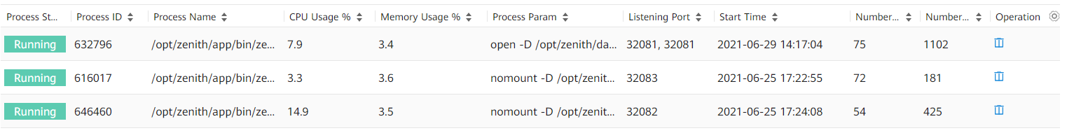
Scenario 6: Monitoring the Online Statuses of Key Service Processes to Prevent Service Interruption
Operating System
Database
Web Application
Customer concerns: No common management protocol can be used to manage historical applications. The service status needs to be monitored based on process information.
Operating system monitoring capability:
Information about whether key service processes are down can be collected.
The CPU and memory usage of key service processes can be collected.
Information about the listening ports of key service processes can be collected.

Slide 22
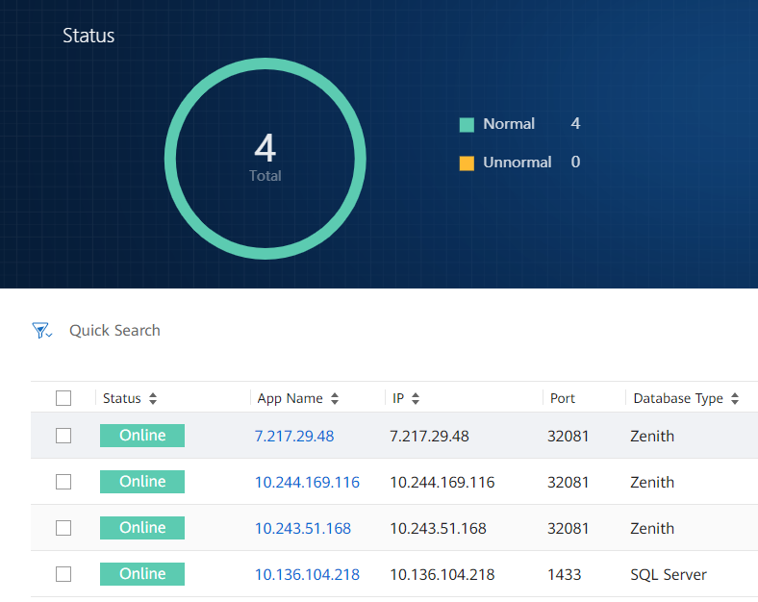
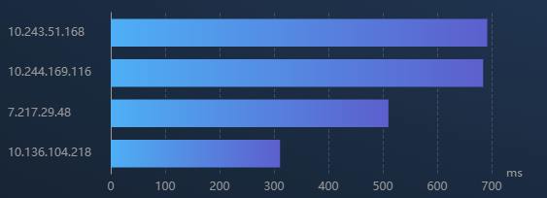
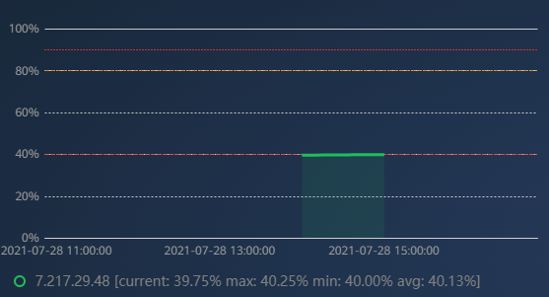
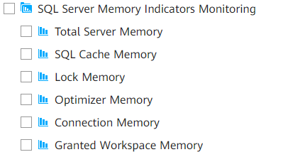
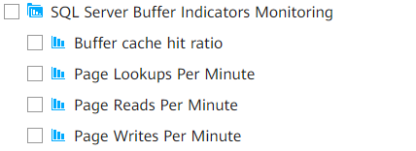
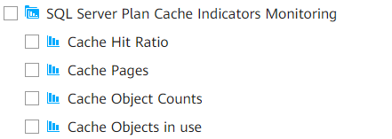
Monitoring Database Availability
Operating System
Database
Web Application
Centrally monitoring network-wide database connectivity
Detecting risks in a timely manner based on top N connections and response time
The availability of databases on the entire network is evaluated based on the database connectivity chart.
Unavailable databases can be detected and displayed based on the database details.
Top N databases are ranked based on the connection proportion and response time to detect high-risk devices in a timely manner.
O&M personnel can analyze potential risks based on the device connection proportion, response time, and historical trends.
Various SQL Server KPIs are provided to help O&M personnel detect underlying database problems.

Slide 23

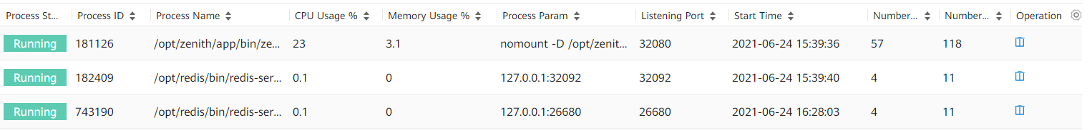
Monitoring Web Application Availability and User Experience
Operating System
Database
Web Application
Centrally monitoring the network-wide application connectivity
Simulated application detection improves access experience
eSight proactively performs dialing tests on applications and collects application response time data, helping users detect slow-response applications in a timely manner.
The response time of network-wide applications is ranked to help users identify poor-QoE applications and improve application experience.
Office
DC
Simulated detection
Application A
Application B
eSight
Using the operating system management capability to monitor application process loads (CPU, memory, number of threads, and number of handles)

